Slide 1
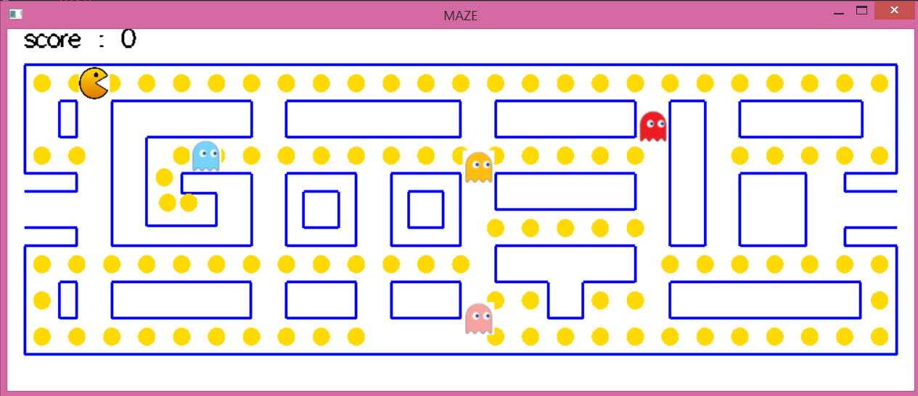
Pac-man
One level

Slide 2
Files of codes
1-”maze”
It is the main program
2-”funcs”
It contains most of functions
3-”tex”
It contains the class of texture.
4-”try”
It contains the code of determining the points of cheese and it represents one of primary versions of code.

Slide 3
EXPLANATION OF THE GAME:
1- cheese .
2-motion of pac_man (arrows) .
3-collision of pac-man with obstacles.
4-random motion of monsters.
5-collision of pac-man with monsters
6-collision of pac-man with cheese /score .
7-textures.
8-sound.

Slide 4
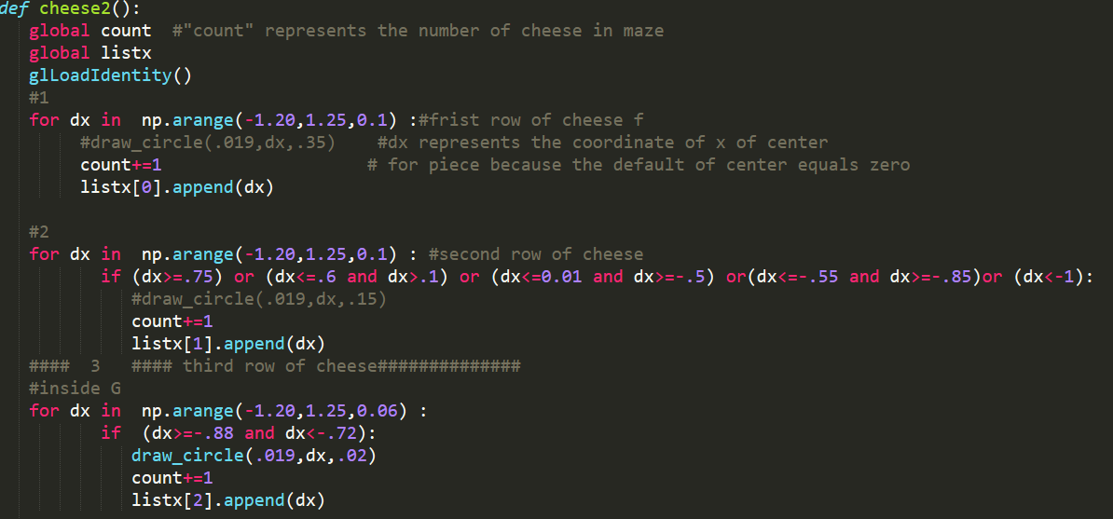
Stages of drawing cheese
The idea of getting the points of pieces of cheese:
1-we determined the coordinates for y (to draw rows of pieces of cheese)
2-for every row ,we determine the possible coordinates of x where there aren’t obstacles as following:-

Slide 5
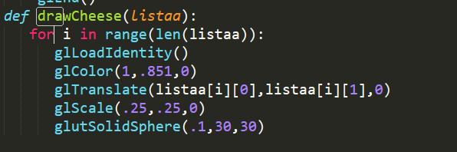
Stages of drawing cheese
3-we made 2 lists(listx , listy) in one list in which every element represents point of center of piece of cheese by using function.
4-we run this function in separate file and the result of running of this function is the final list.
5- then we used code to convert this result from string to the ordinary list and we copy it(the list) and put it in the major program as following:-
6-finally, we used the following function to draw pieces of cheese:

Slide 6
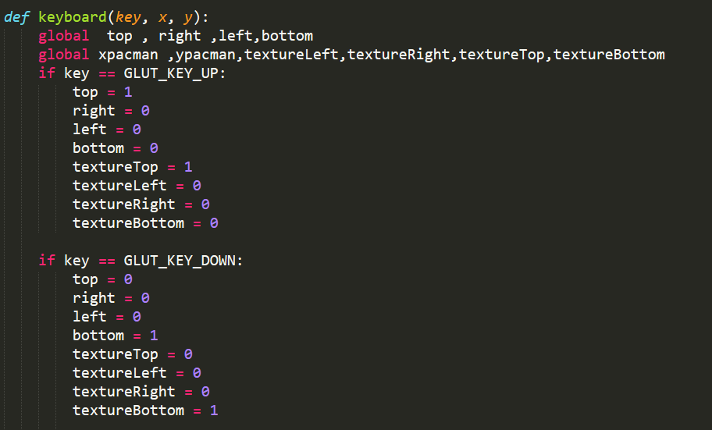
Motion of pac-Man
-we make pac-man move respect to arrows of keyboard(special keys)
And so on

Slide 7
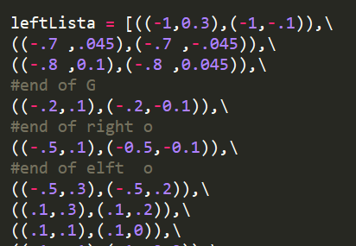
collision of pac man with obstacles
1-we made list for every border of obstacle(left ,right , bottom ,top) that contains the points of border .
ex:leftlista

Slide 8
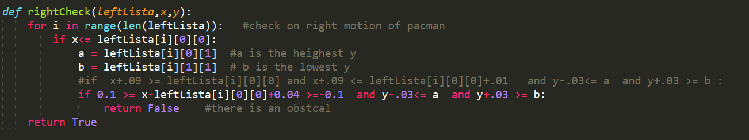
collision of pac man with obstacles
2-we made function for every direction of motion of pac-man and check if there is any obstacle in this direction (for example : if pac- man moves in left direction we must check if right border of all obstacles)

Slide 9
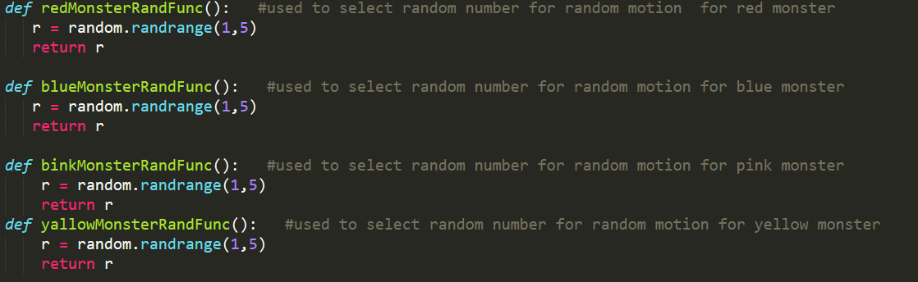
Random motion of monsters
1-we made function for every monster to choose randomly from [1:4]
Note:- function for every monster to try to make them move in different directions respect to each other(functions select different numbers)

Slide 10
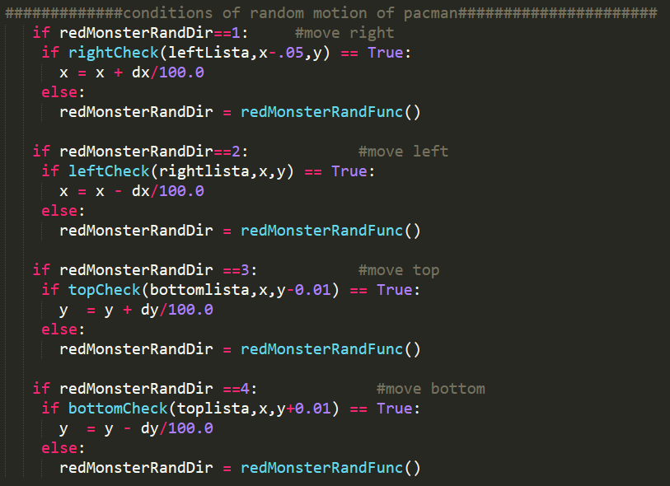
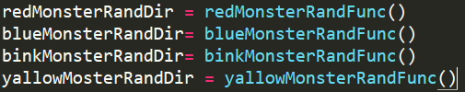
Random motion of monsters
2- every number used for motion in specific direction
3-we check the collision of every monster with obstacles like pac-man
Example:- Red monster

Slide 11
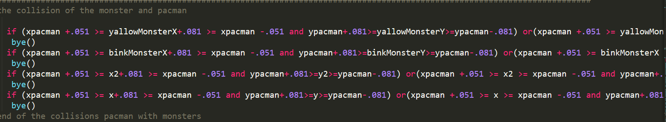
collision of pac man with monsters

Slide 12
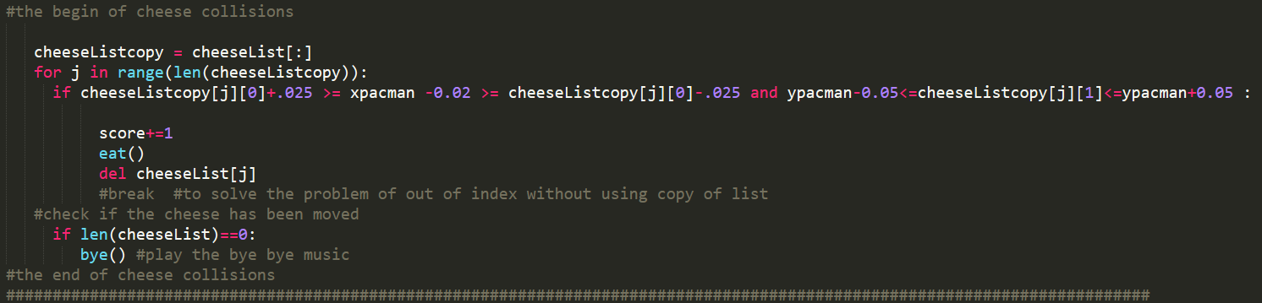
collision of pac man with cheese & score
-We check the collision and if it happens:-
1-we delete the point of center of piece of cheese from the list not to draw again in every run of display function.
2-increase the score by 1
3-if the list becomes empty , the bye music displays and the game ends

Slide 13
Textures
1-texture for pac-man
2-textures for monsters
Intro:-
-We converted the pac-man from spheres to rectangles(because of textures) but we consider them as circles for collision.
We made class for textures (for man &monsters)-

Slide 14
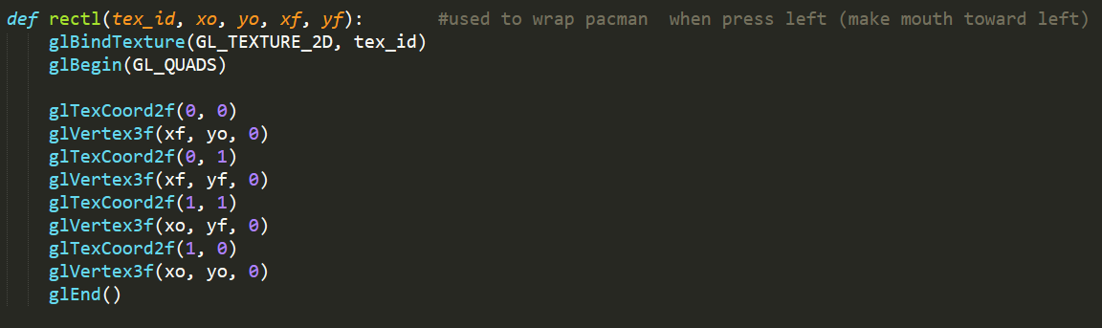
Textures
1-texture for pac-man
Because of the mouth of pac that changes with the direction of motion,
We made for functions to wrap texture of man in 4 cases of motion
For example:--

Slide 15
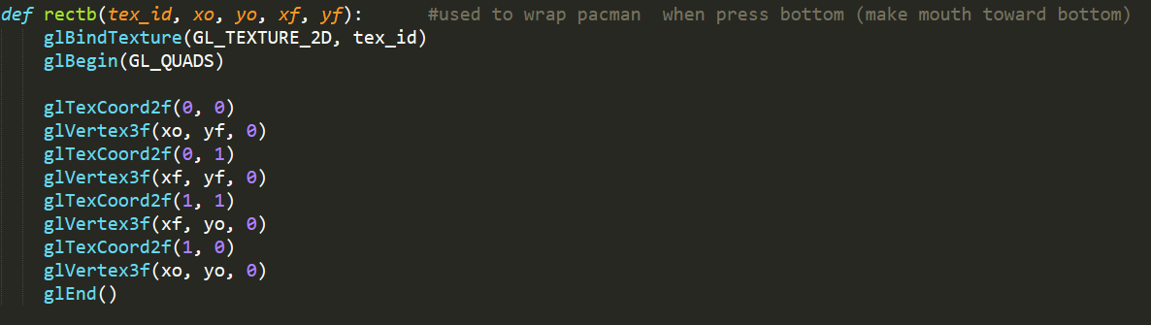
Textures
2-textures for monsters
-because of not changing of texture of monsters during motion, we made only function to wrap monsters.

Slide 16
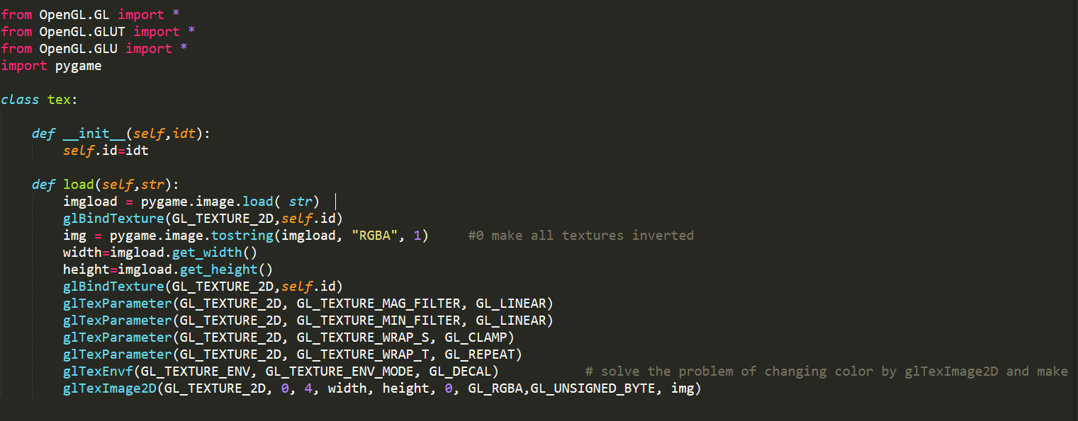
Textures
-class for textures

Slide 17
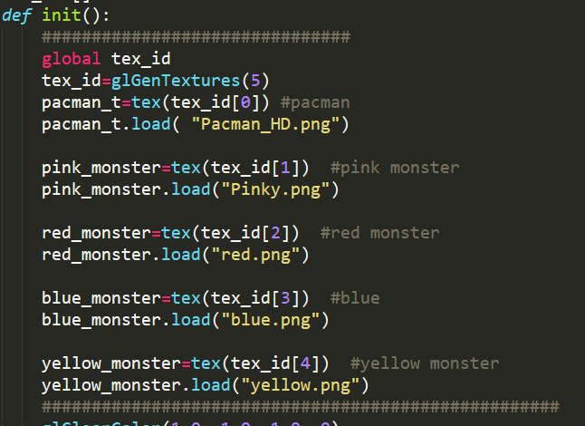
Textures
-class for textures
We made object for man and every monster.
-

Slide 18
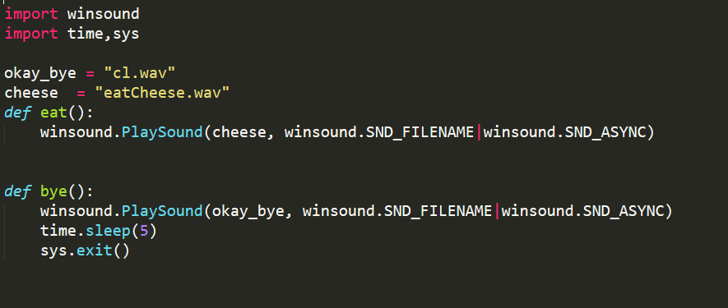
sound
-We use 2 sounds(one for eating cheese and another one for collision of man with monsters).

Slide 19
the maze team:
Hanan bahy
Yasmin barakt
Mostafa tarek
Habiba Khaled
Ibrahim mohame
Rehab reda
Dalia roshdy
Aya Rashad
Eman Mahmoud
Ominah abd el_khalek

